Slide 2
Outline
Introduction
Objectives
Methods
Results
Discussion
Conclusions
References

Slide 3
Introduction
The increasing threat of antimicrobial led to a shortage of available treatment options, particularly for MDR Gram-negative bacterial infections.
To address this issue, new strategies are needed, including repurposing non-antibiotic drugs for antimicrobial therapy.
In this study, the authors evaluate six anticancer agents for their ability to eradicate MDR Gram negative bacteria, both as stand-alone agents and in combination with a previously reported adjuvant, TOB-CIP.
The results suggest that mitomycin C, in particular, has potent antibacterial activity against several Gram-negative bacterial strains and may be a promising candidate for antimicrobial therapy, especially when used in combination with TOB-CIP.

Slide 4
Objectives
To investigate the efficacy of a novel combination therapy involving tobramycin-ciprofloxacin hybrid and the anticancer drug mitomycin C against multidrug-resistant Gram-negative bacteria.
The paper aims to demonstrate that this repurposed combination therapy can overcome antibiotic resistance and enhance the activity of the anticancer drug against bacterial infections, thereby providing a potential new treatment option for patients with drug-resistant infections.
The study also seeks to explore the mechanism of action behind this synergistic effect and to evaluate the safety and toxicity of the combination therapy in vitro and in vivo.

Slide 5
Methods
Checkerboard assay .
Preparation of TOB-CIP hybrid
Bacterial strains and growth conditions
Antimicrobial susceptibility assay .

Slide 6
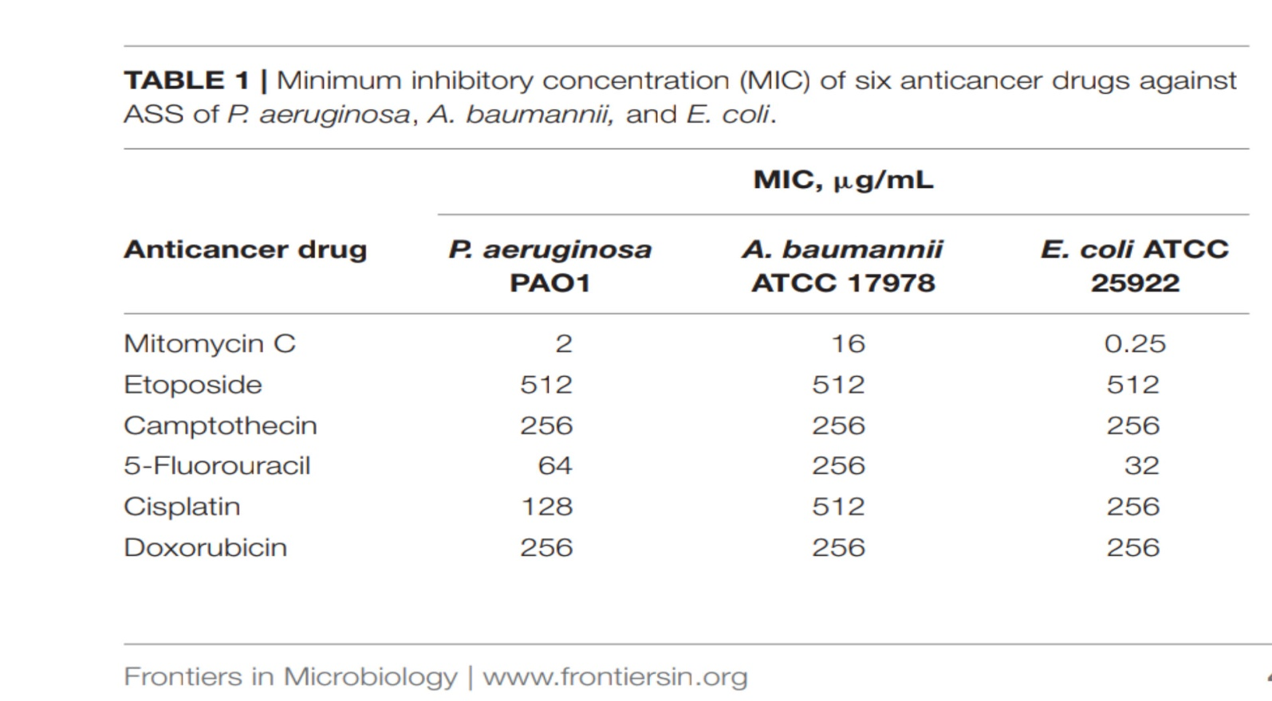
Results
1) Mitomycin C Possessed Potent Antibacterial Activity Against Gram-Negative Bacteria.

Slide 7
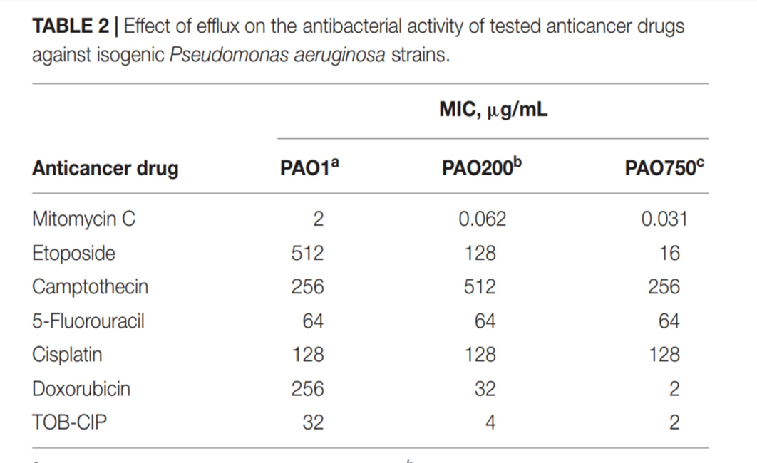
2) Efflux in P. aeruginosa Affected the Antibacterial Activity of Mitomycin C, Etoposide and Doxorubicin.

Slide 8
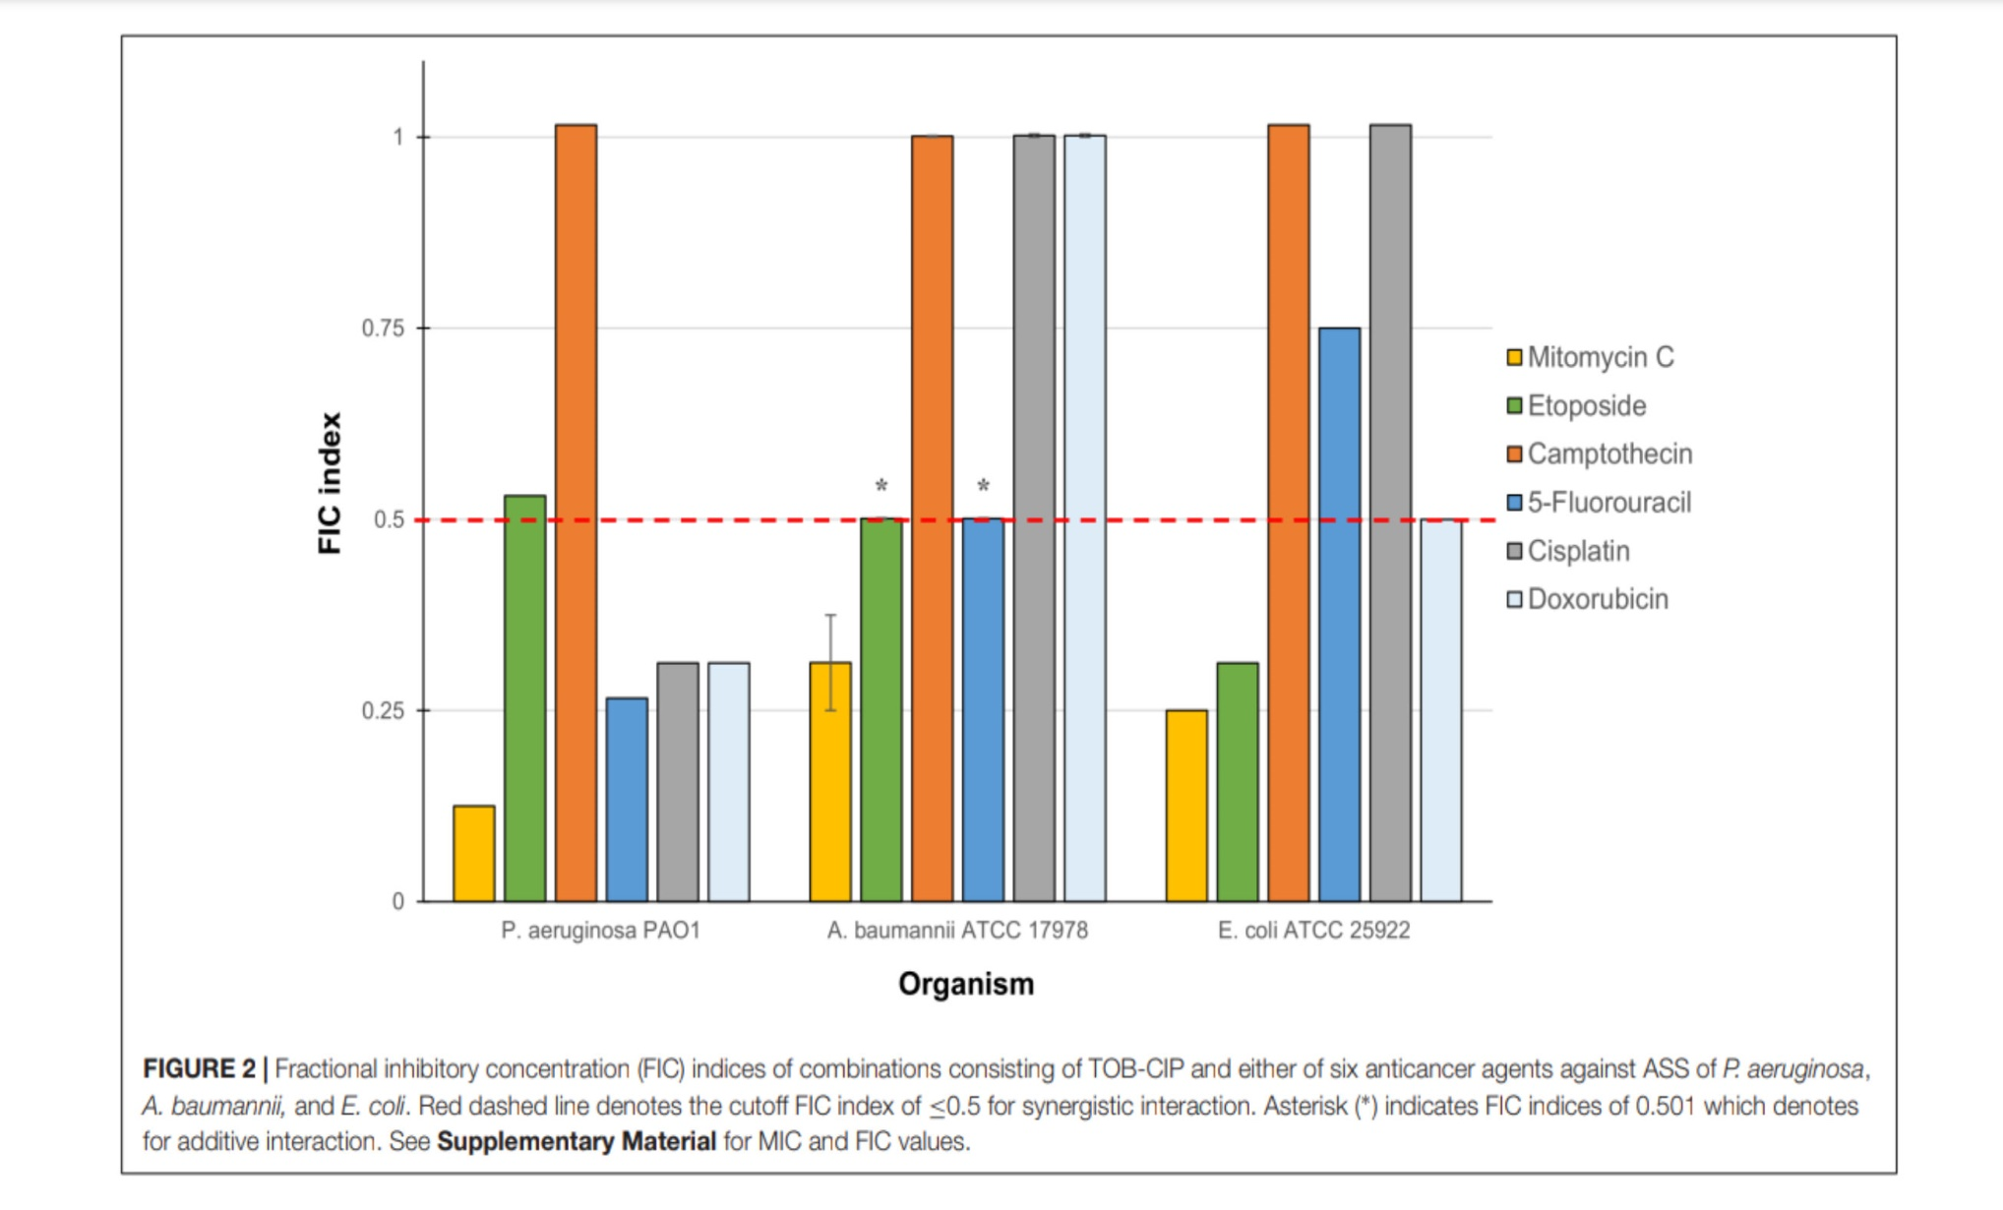
3) TOB-CIP Enhanced Antibacterial Activity of Mitomycin C Against ASS of Gram-Negative Bacteria .

Slide 9
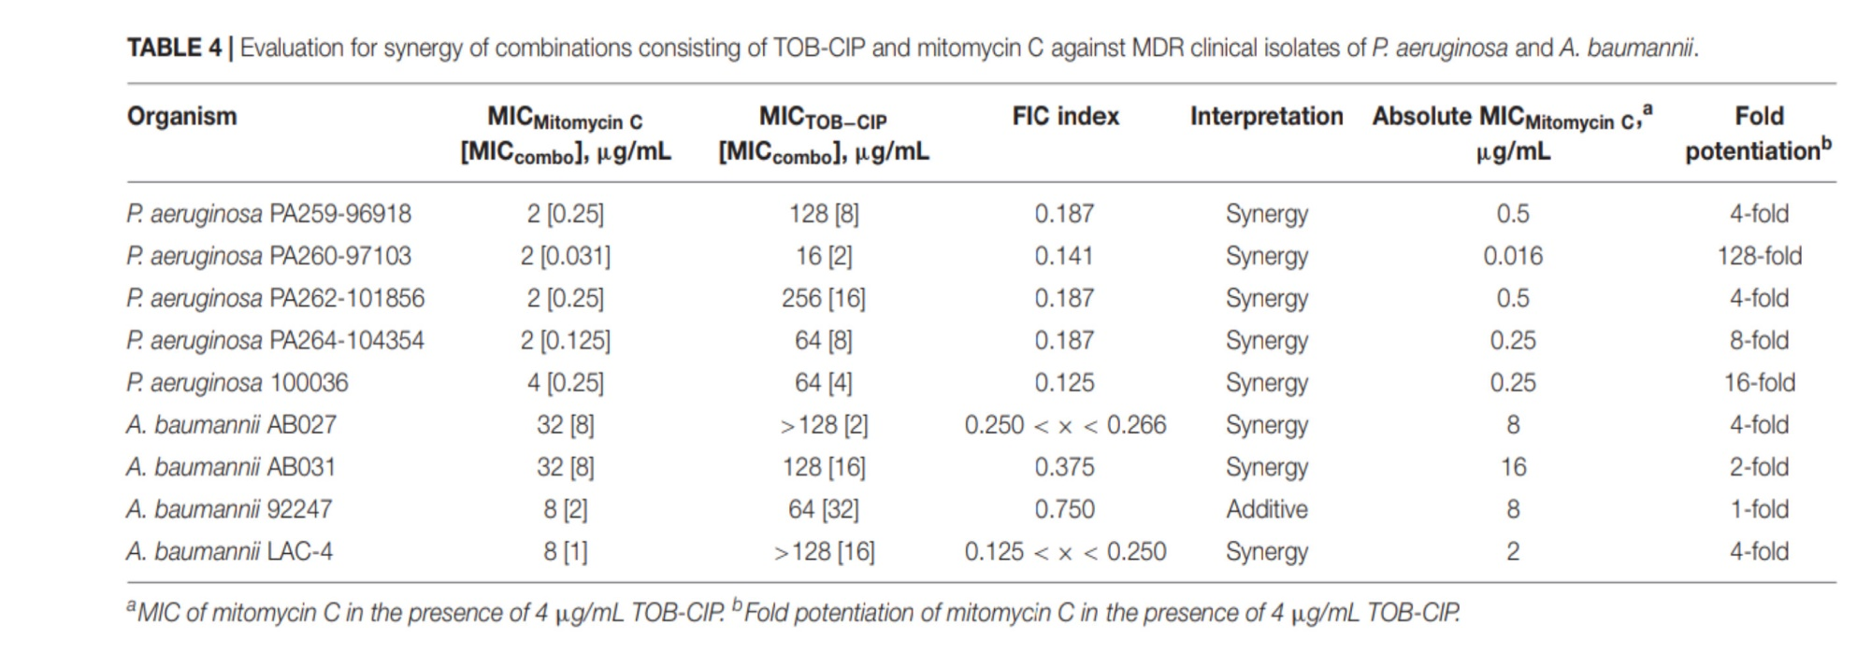
4) TOB-CIP Enhanced Antibacterial Activity of Mitomycin C Against ASS of Gram-Negative Bacteria.

Slide 10
Discussion
The paper explores the use of a tobramycin-ciprofloxacin hybrid and mitomycin C in combination to combat multidrug-resistant Gram-negative bacteria.
The research suggests the potential of repurposing existing drugs to create new treatment options for drug-resistant bacterial infections

Slide 11
Conclusions
The combination of tobramycin and ciprofloxacin can enhance the effectiveness of the anticancer drug mitomycin C against multidrug-resistant gram-negative bacteria.
The use of repurposed antimicrobial combination therapy is a potential strategy for combating antibiotic-resistant bacteria.
The hybridization of different antimicrobial drugs can lead to improved treatment options for infections caused by drug-resistant bacteria.
The study's findings may have significant implications for the development of new therapies and the repurposing of existing drugs to combat the growing problem of antibiotic resistance.

Slide 12
References
Bradner, W. T. (2001). Mitomycin c: a clinical update. Cancer Treat. Rev. 27, 35–50. doi: 10.1053/ctrv.2000.0202
Cavalla, D. (2019). Using human experience to identify drug repurposing opportunities: theory and practice. Br. J. Clin. Pharmacol. 85, 680–689. doi:10.1111/bcp.13851
Cheng, Y. S., Sun, W., Xu, M., Shen, M., Khraiwesh, M., Sciotti, R. J., et al. (2018). Repurposing screen identifies unconventional drugs with activity against multidrug resistant Acinetobacter baumannii. Front. Cell. Infect. Microbiol. 8:438. doi: 10.3389/fcimb.2018.00438
Choi, Y. H., and Yu, A.-M. (2014). ABC transporters in multidrug resistance and pharmacokinetics, and strategies for drug development. Curr. Pharm. Des. 20,793–807 . doi: 10.2174/138161282005140214165212
Crooke, S. T., and Bradner, W. T. (1976). Mitomycin c: a review. Cancer Treat. Rev. 3, 121–139.
Yang, X., Goswami, S., Gorityala, B. K., Domalaon, R., Lyu, Y., Kumar, A., et al. (2017). A tobramycin vector enhances synergy and efficacy of efflux pump inhibitors against multidrug-resistant gram-negative bacteria. J. Med. Chem. 60,3913–3932. doi: 10.1021/acs.jmedchem.7b00156

Slide 13


